Slide 1


The Bayesian Block Algorithm
discover local structures in background data
Raffaele Gaudio
2057974

Slide 2
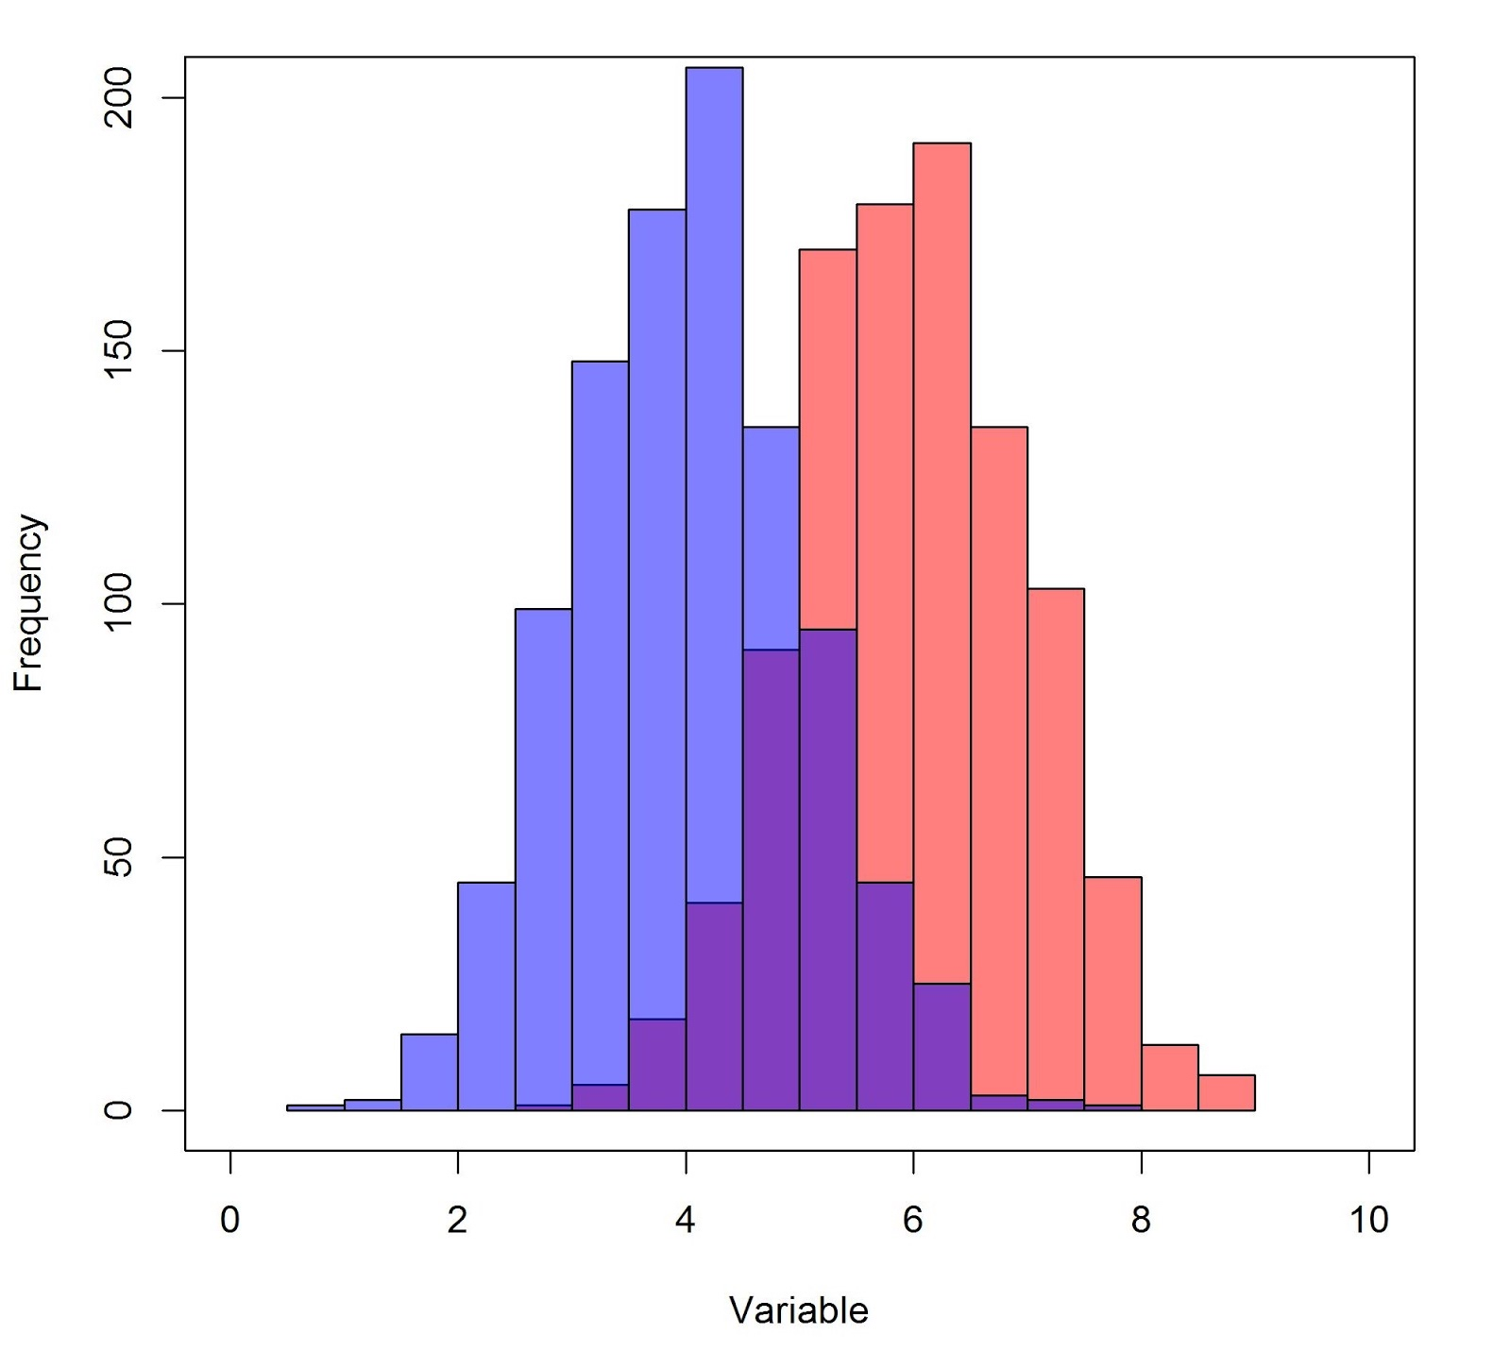
The problem: data visualization
Sometimes it’s hard!
What is the best data segmentation for our data?
Am I using all the information I have?

Slide 3
The Bayesian Block representation
The Bayesian Blocks representation is a non parametric representation of data derived with a bayesian statistical procedure.
Invented by Jeffrey D. Scargle and applied in the context of astronomical time series analysis [1].

Slide 4
Features in our wish list
Non-parametric: generic representation of data
Discover local structures in background data exploiting the full information brought by the data
Impose few preconditions as possible on signal and background shapes
Handle arbitrary sampling and dynamic ranges of data
Operate in a bayesian framework and work with posterior probabilities:
P(M|D) ∝ P(D|M)P(M)

Slide 5
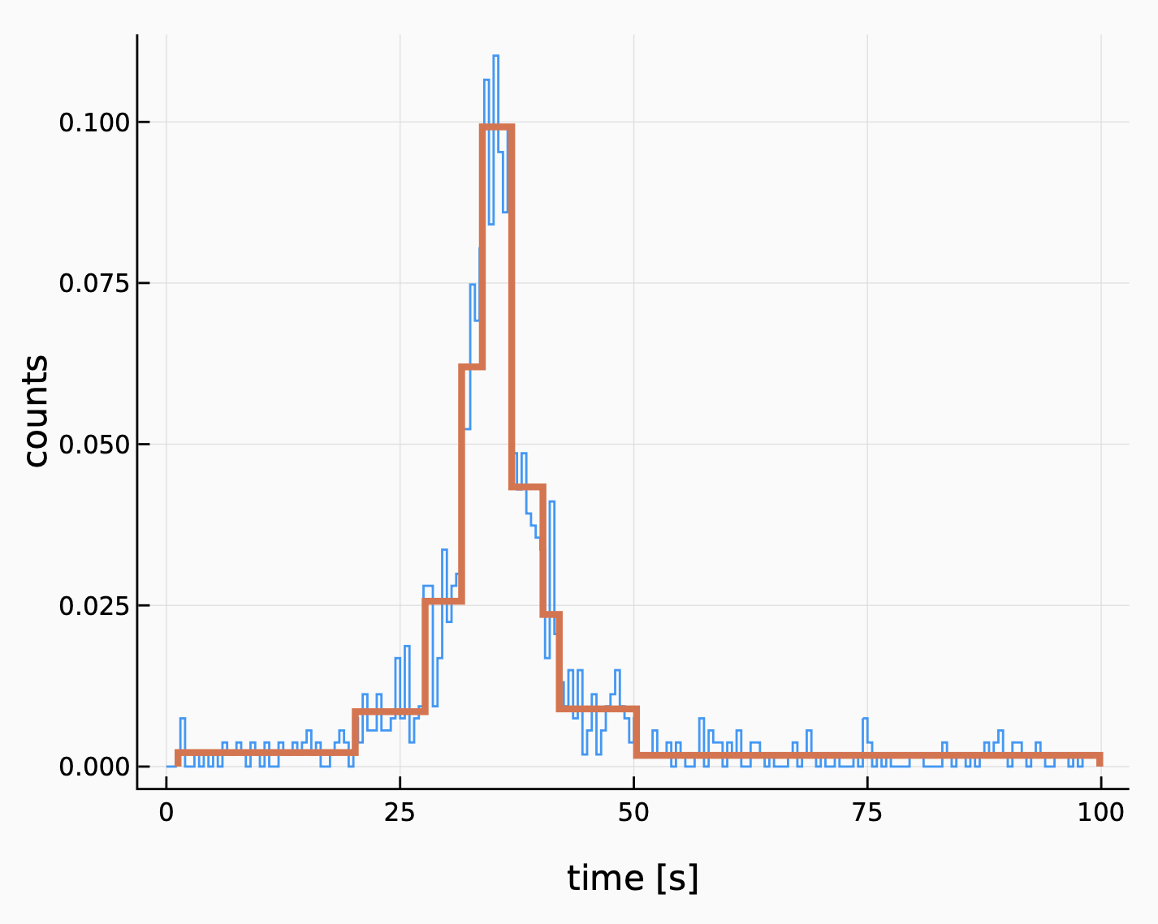
Idea of the BB algorithm
Segmentation of the data interval into variable-sized blocks, each block containing consecutive data elements satisfying some well-defined criterion. The optimal segmentation is the one that maximize some quantification of this criterion.
Image by Luigi Pertoldi [pertoldi@pd.infn.it]

Slide 6
The Piecewise Constant Model
The range of the independent variable (e.g. time) is divided into subintervals generally unequal in size, in which the dependent variable (e.g. intensity) is modeled as constant within errors.
the blocks can be treated independently (block’s fitness depends on its data only)
Our model for each block has two parameters:
the signal amplitude, and is treated as a nuisance parameter
the length of the interval spanned by the block
Recipe: build the fitness function and than marginalize (maximize/minimize) w.r.t. the nuisance parameters

Slide 7
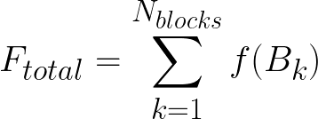
The fitness function
The algorithm relies on the additivity of the fitness function:
our best model is the one that maximize F_{total} over all possible partitions.
From a Bayesian point of view the fitness function corresponds to the likelihood
P(D|M)

Slide 8
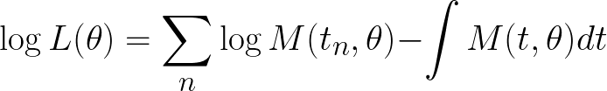
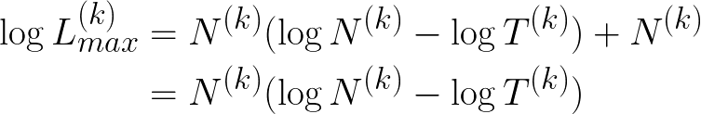
The fitness function - Cash Statistics
With a model M(t,𝜃), the unbinned log-likelihood reads:
our model is constant: M(t,𝜆) = 𝜆 so for block k
now we maximize wrt the nuisance parameter 𝜆 (height of the block):

Slide 9
The fitness function - Cash Statistics
With a model M(t,𝜃), the unbinned log-likelihood reads:
our model is constant: M(t,𝜆) = 𝜆 so for block k
now we maximize wrt the nuisance parameter 𝜆 (height of the block):
independent of the partition

Slide 10
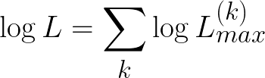
The fitness function - Cash Statistics
where N^{(k)} number of events and T^{(k)} is the length of the Kth block.
This fitness function has two nice features:
is simple
is scale invariant (T→𝛼T)
The fitness of the entire partition will be then:

Slide 11
The Prior on the number of blocks
We are interested in a representation where N_{blocks}≪ N rather than N_{blocks}≈ N
Uniform prior looks unreasonable
We selected two candidate priors for our algorithm that assign smaller probability on a large number of blocks:
Geometric Prior
Calibrated Prior

Slide 12
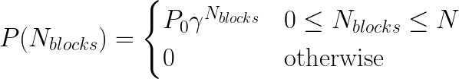

Geometric Prior
𝛾 is a free parameter
we need to tune this parameter…

Slide 13
Geometric Prior
𝛾 is a free parameter
we need to tune this parameter…
The prior can be interpreted as a control on the false-positive rate for detecting change-points.
fixing the rate of Type-I errors

Slide 14
Geometric Prior
𝛾 is a free parameter
we need to tune this parameter…
The prior can be interpreted as a control on the false-positive rate for detecting change-points.
fixing the rate of Type-I errors
Recipe: running the algorithm with a few different values. In general, the number of change-points is insensitive to a large range of reasonable values of the “steepness” parameter.

Slide 15
Calibrated Prior
Another approach is to calibrate the prior as a function of the number of data points N and the false-positive rate p₀ on toy pure-noise experiments.
p₀ represents the frequency with which the algorithm correctly rejects the presence of a change-point in pure noise.

Slide 16
Algorithm structure
The algorithm takes in several parameters:
data: the input data to be partitioned
data_type: the type of input data (array or histogram)
prior: the prior distribution to use (geometric or calibrated)
gamma: the slope of the geometric prior
p0:the correct detection rate parameter for the calibrated prior
verbose:a boolean parameter that if set True prints useful informations on the algorithm
The algorithm starts by sorting and counting the data, then it creates a set of possible bin edges. The function then evaluates the fitness function for each possible partition, taking into account a prior distribution on the number of blocks. The algorithm then traces back through the previous partitions to find the optimal partition that maximizes the fitness function. The change points are then returned as the edges of the blocks.

Slide 17
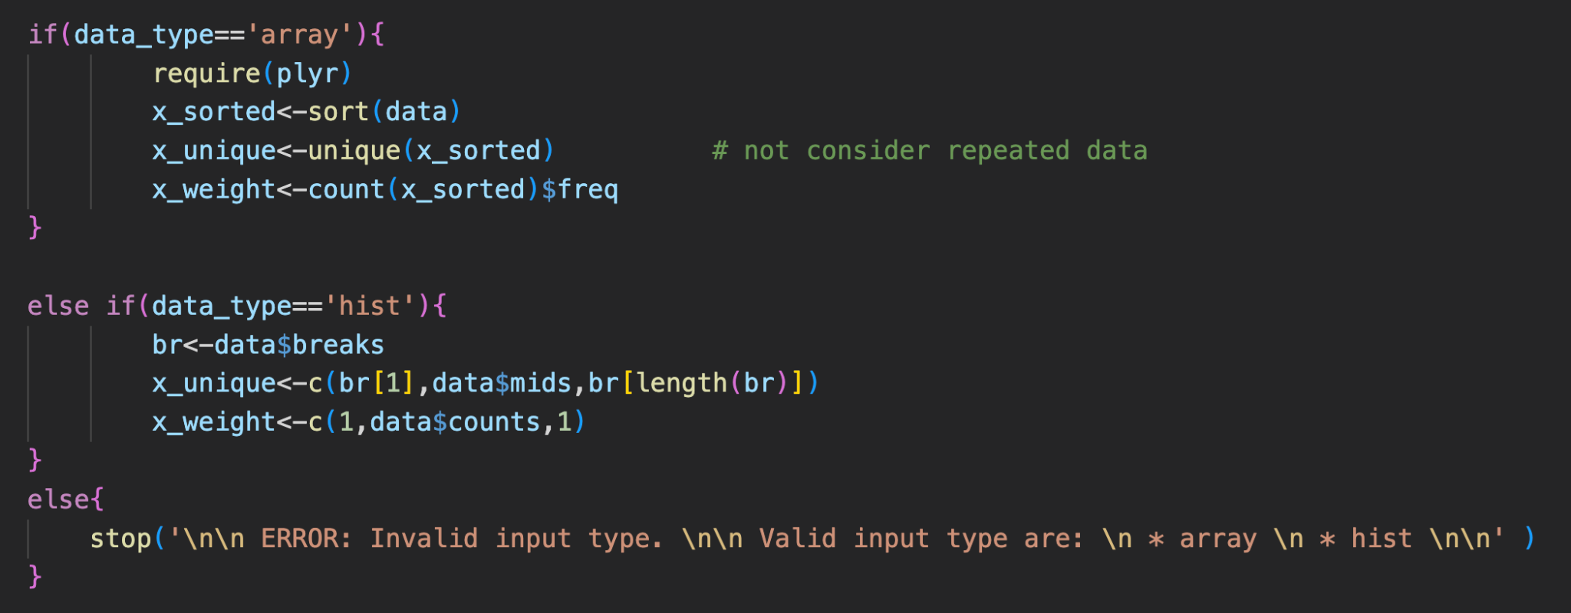
Algorithm structure

Slide 18
Algorithm structure
Sort the data in ascending order.

Slide 19
Algorithm structure
Sort the data in ascending order.
Select only unique data.

Slide 20
Algorithm structure
Sort the data in ascending order.
Select only unique data.
Count the frequency of each unique values.

Slide 21
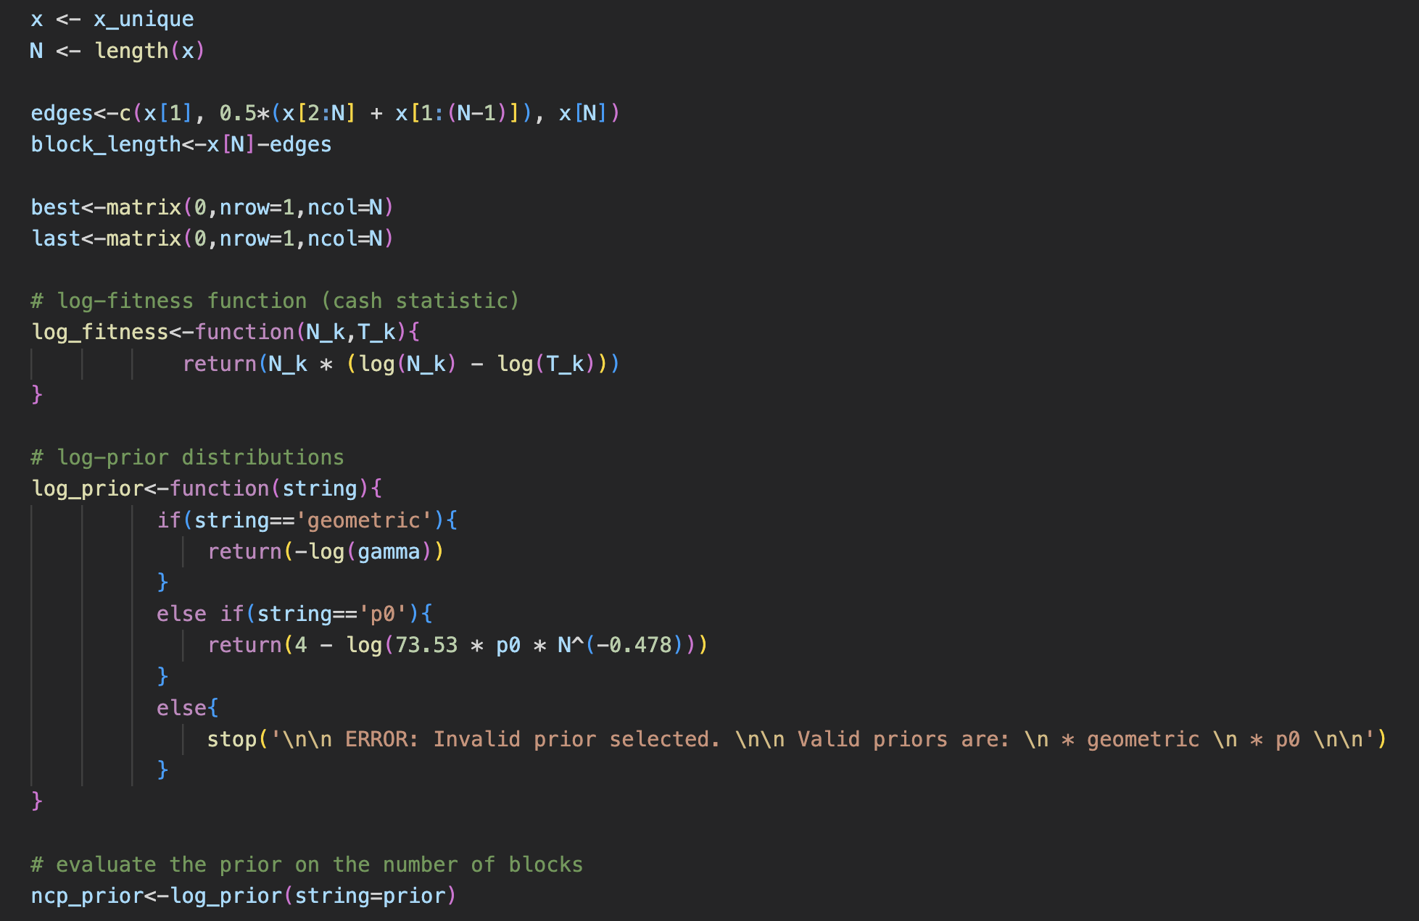
Algorithm structure

Slide 22
Algorithm structure
Compute the initial block edges by taking the midpoint between each adjacent pair of unique values in x, and appending the minimum and maximum values of x to the beginning and end, respectively. This results in N+1 edges and N blocks.

Slide 23
Algorithm structure
Compute the initial block edges by taking the midpoint between each adjacent pair of unique values in x, and appending the minimum and maximum values of x to the beginning and end, respectively. This results in N+1 edges and N blocks.
The block length is calculated as the difference between the final block edge and each of the block edges.

Slide 24
Algorithm structure
Compute the initial block edges by taking the midpoint between each adjacent pair of unique values in x, and appending the minimum and maximum values of x to the beginning and end, respectively. This results in N+1 edges and N blocks.
The block length is calculated as the difference between the final block edge and each of the block edges.
The best and last matrices are initialized to be zero matrices with dimensions (1, N). These matrices are used to keep track of the optimal partition of the data at each step of the algorithm.

Slide 25
Algorithm structure
Compute the initial block edges by taking the midpoint between each adjacent pair of unique values in x, and appending the minimum and maximum values of x to the beginning and end, respectively. This results in N+1 edges and N blocks.
The block length is calculated as the difference between the final block edge and each of the block edges.
The best and last matrices are initialized to be zero matrices with dimensions (1, N). These matrices are used to keep track of the optimal partition of the data at each step of the algorithm.
The fitness function and the priors functions are defined.

Slide 26
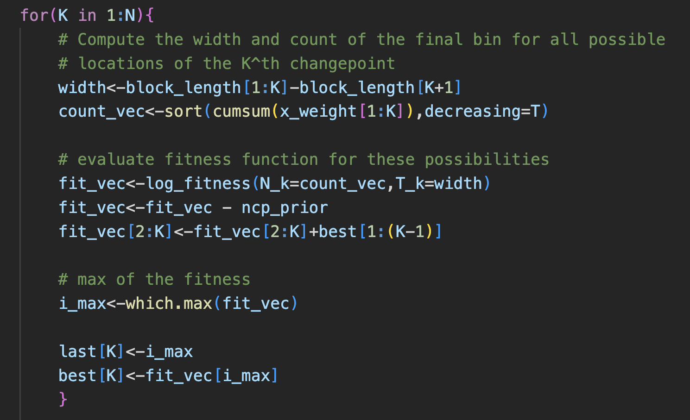
Algorithm structure

Slide 27
Algorithm structure
Evaluate the width of each block

Slide 28
Algorithm structure
Evaluate the width of each block
Compute the cumulative sum of the weights of the unique values up to the Kth index, and then sorts it in descending order.

Slide 29
Algorithm structure
Evaluate the width of each block
Compute the cumulative sum of the weights of the unique values up to the Kth index, and then sorts it in descending order.
Compute the fitness.

Slide 30
Algorithm structure
Evaluate the width of each block
Compute the cumulative sum of the weights of the unique values up to the Kth index, and then sorts it in descending order.
Compute the fitness.
Update the fitness values of all but the first possible changepoint locations by adding the best fitness values of all previous possible change-point locations.

Slide 31
Algorithm structure
Evaluate the width of each block
Compute the cumulative sum of the weights of the unique values up to the Kth index, and then sorts it in descending order.
Compute the fitness.
Update the fitness values of all but the first possible changepoint locations by adding the best fitness values of all previous possible change-point locations.
Find the location of the maximum value in the fit_vec vector, which corresponds to the location of the Kth change-point that maximizes the log-likelihood of the data.

Slide 32
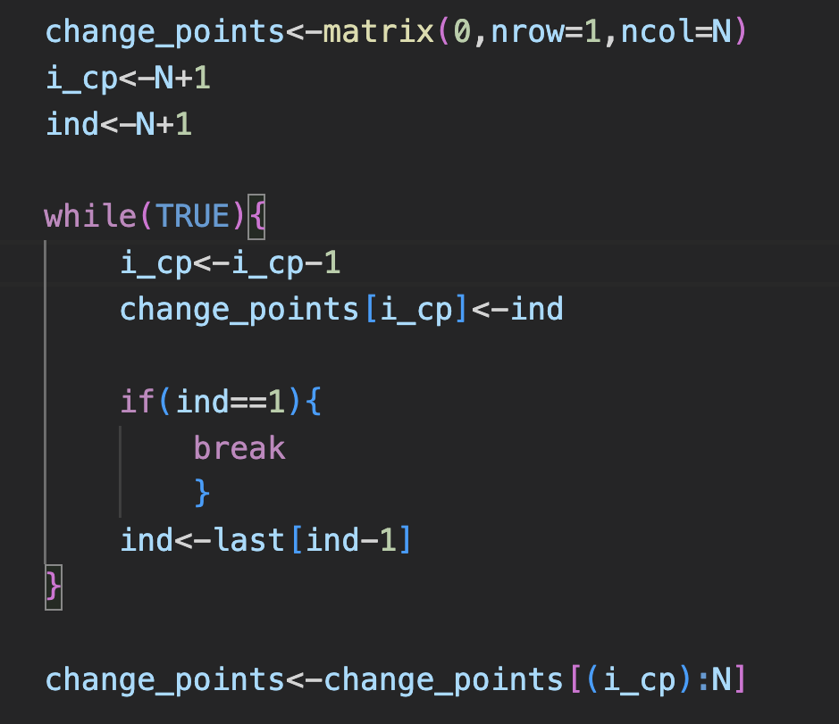

Algorithm structure

Slide 33
Algorithm structure
Determining the locations of the changepoints that form the optimal partitioning of the input data. The while loop starts from the last block and iteratively backtracks through the changepoints to identify their location, until it reaches the first block.

Slide 34
Algorithm structure
Determining the locations of the changepoints that form the optimal partitioning of the input data. The while loop starts from the last block and iteratively backtracks through the changepoints to identify their location, until it reaches the first block.
Return the vector of the estimated bin edges.

Slide 35
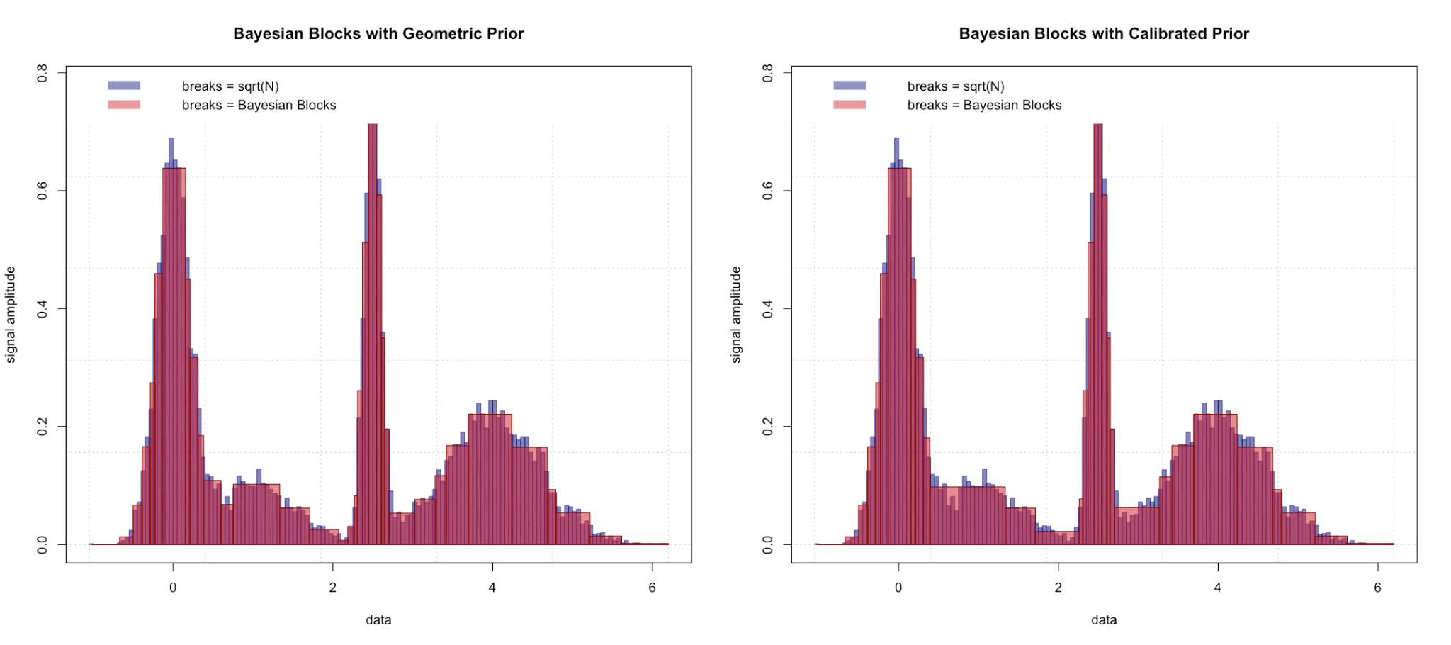
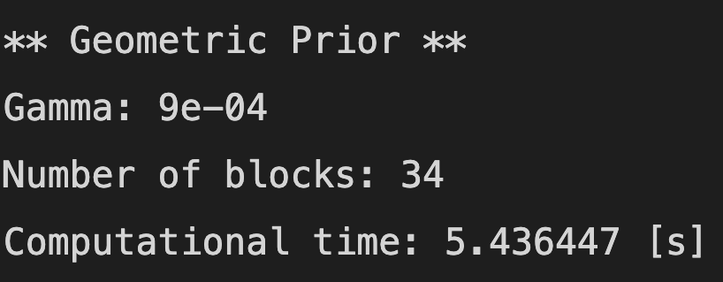
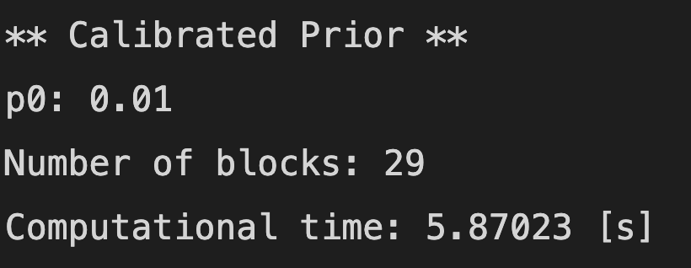
Applications: Binning of histograms
1500 random toy data generated from a mixture of four normal distributions (122 bins)

Slide 36
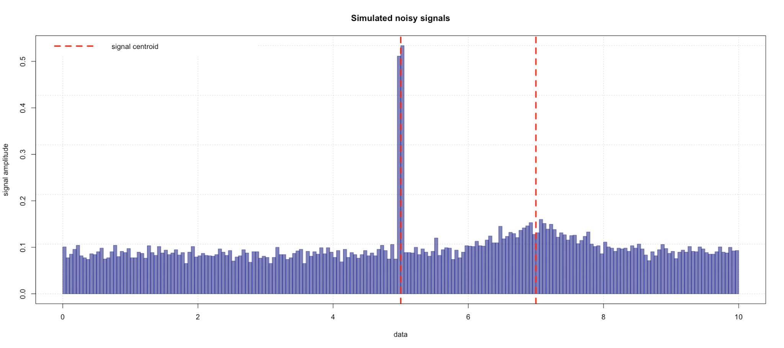
Applications: Signal detection
Uniform background noise with two gaussian signals (N (5,0.01), N (7,0.6))

Slide 37
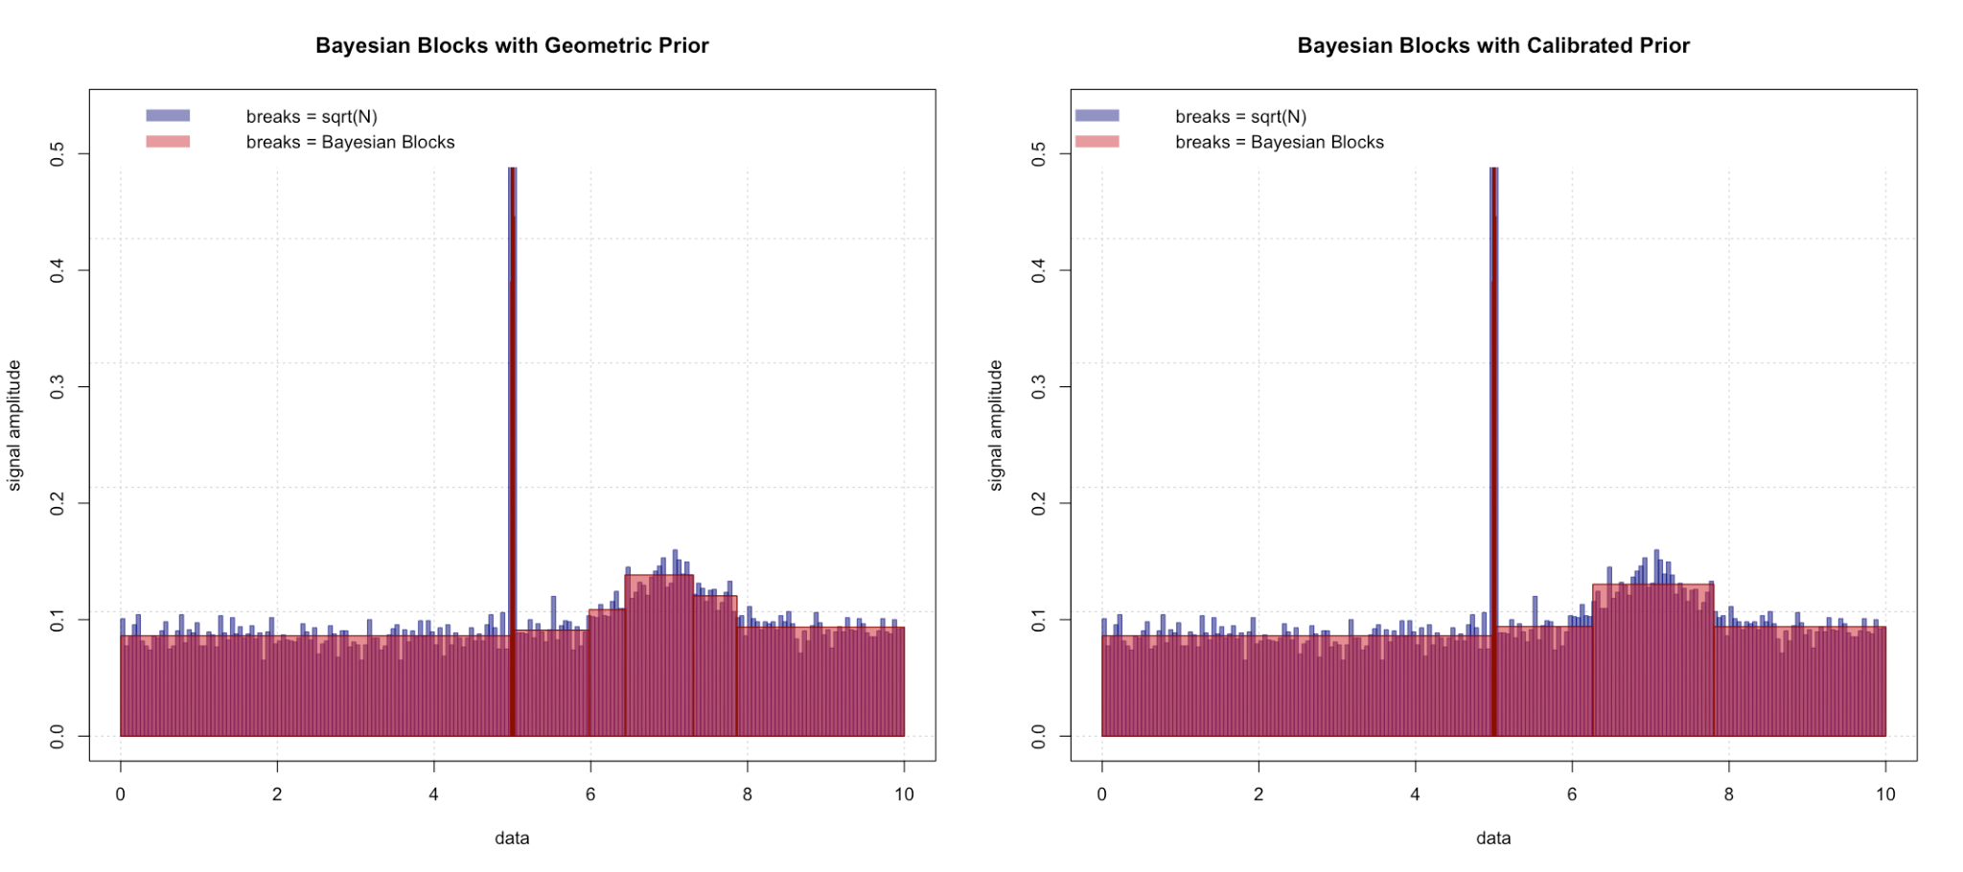
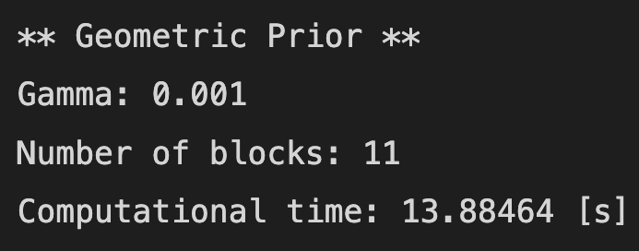
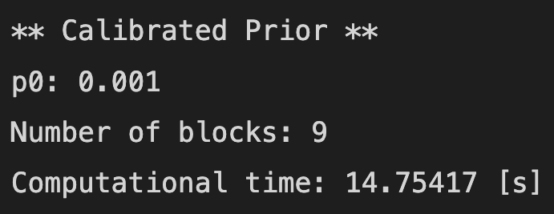
Applications: Signal detection

Slide 38
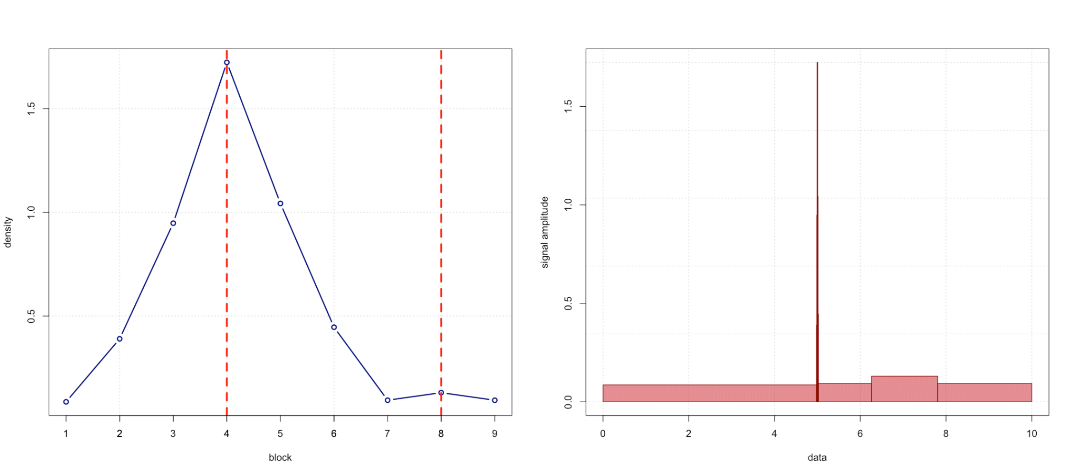
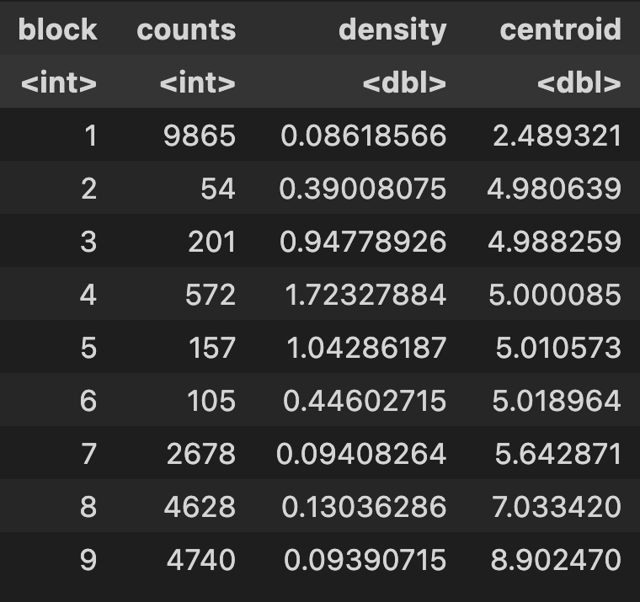
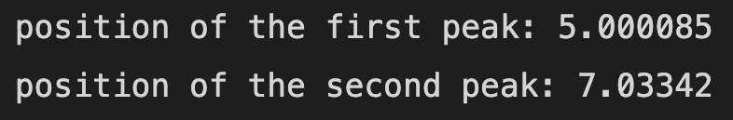
Applications: Signal detection
Information on single block can be easily inspected using the usual R’s syntax for histograms.

Slide 39
Applications: Kernel density estimator for SBAM
PySINDy is a sparse regression package with several implementations for the Sparse Identification of Nonlinear Dynamical systems (SINDy) [7].
The SBAM (Sparse Bayesian Auxiliary Module ) [5] [6] module provides a bayesian implementation for the sparsity in the original PySindy package. Through the use of a Gibbs Sampler, the module provides a posterior probability distribution of the coefficients of the candidate functions (features) that will be used to reconstruct the dynamics of the system.
In the SBAM module, the mean was used as the best estimator for such posterior. With the Bayesian Blocks algorithm, we can implement a kernel density estimator; in this way, the mode can be easily calculated and used as the best estimator for the posterior distributions.

Slide 40
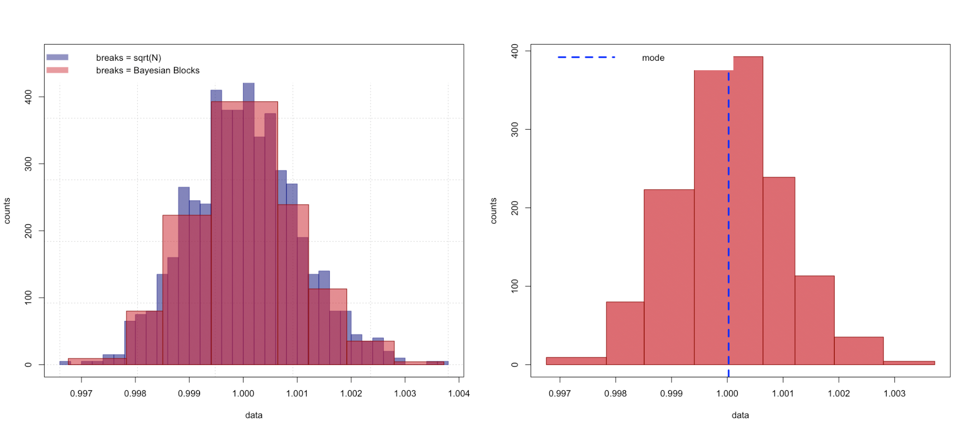
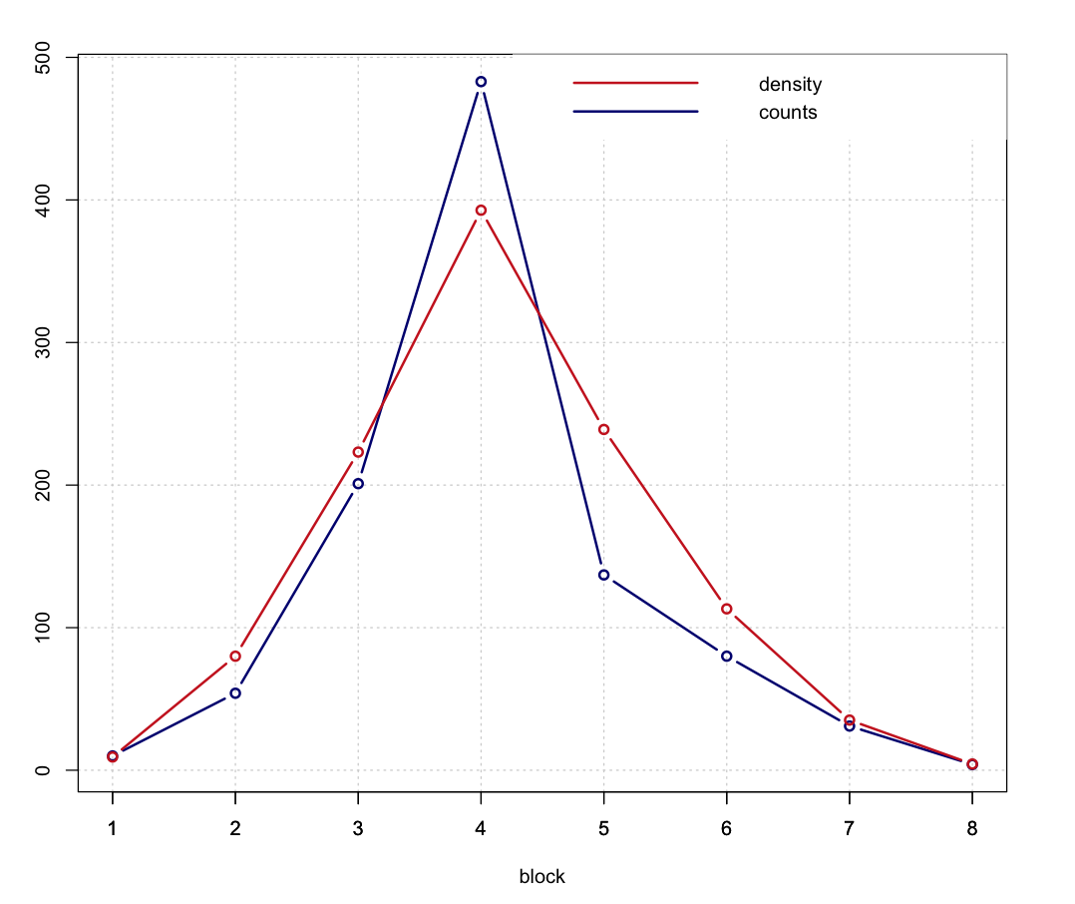
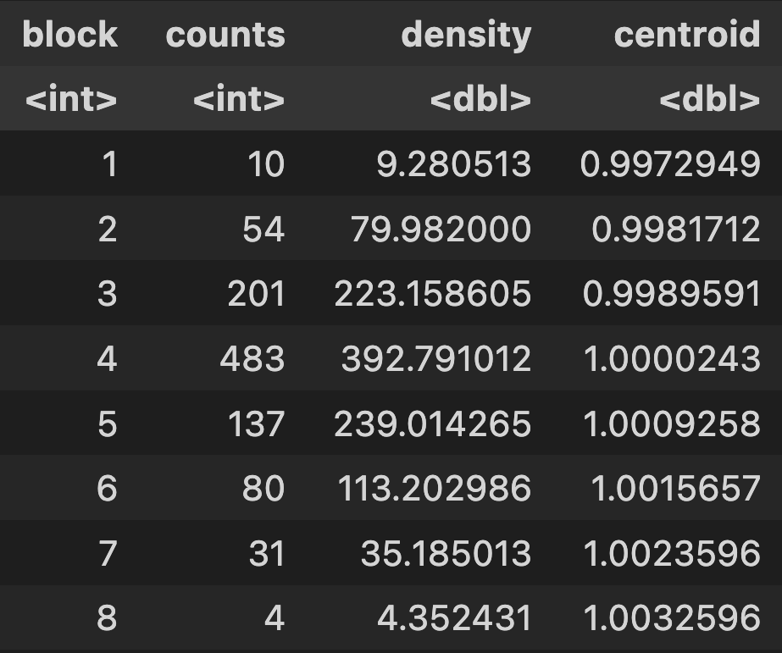
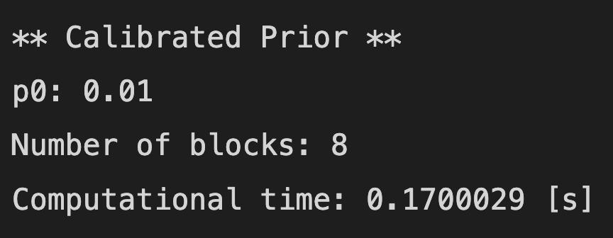
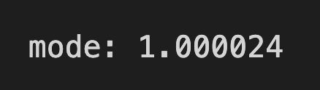
Applications: Kernel density estimator for SBAM

Slide 41
Conclusions
The Bayesian Blocks algorithm provides an objective way for optimal data segmentation.
The algorithm allows us to produce extremely understandable histograms that highlight the local background structure of the data by imposing as few preconditions as possible.
The ease of code implementation and the possibility of customization by introducing new priors, make the Bayesian Block algorithm a powerful tool for studying time series, signal detection and as a kernel density estimator.

Slide 42
References
[1] Studies in Astronomical Time Series Analysis. VI. Bayesian Block Representations, J. D. Scargle et al., Astrophys. J. 764 (2013) 167
[2] Bayesian Blocks in High Energy Physics: Better Binning made easy! B. Pollack et al. (2017), arXiv:1708.00810
[3] Studies in astronomical time series analysis: 5. Bayesian blocks, a new method to analyze structure in photon counting data, J. D. Scargle, Astrophys. J. 504 (1998) 405
[4] https://gist.github.com/gipert/4d245d97e8f7eebbe7cfc3eddbf27b7b (link to the original Julia code for the algorithm)
[5] https://docs.google.com/presentation/d/13ISUiQMHrTVek67IuxL47fNgRsP5JgQvKNSatCu-L6E/edit#slide=id.p (link to the SBAM presentation)
[6] https://github.com/zanocrate/LCPB_2219/tree/master/project (link to the GitHub repo of the SBAM module)
[7] https://pysindy.readthedocs.io/en/latest/# (link to the PySindy documentation)

